Slide 1
LAB - 06
陳培殷
國立成功大學 資訊工程系
Notes:
題目有點太少

Slide 2
Outline
Video preview for 晶片實現 + HDL介紹 (Parts VI)
Sequential Circuit
Lab I – Counter (sequential circuit)

Slide 3
Sequential Circuit (1/3)
A sequential circuit is a system whose outputs at any time are determined from the present combination of inputs and the previous inputs or outputs.
Combinational
Logic Circuit
m output
variables
n input
variables
..
..
Memory
Elements
states
Sequential components contain memory elements
The output values of sequential components depend on the input values and the values stored in the memory elements

Slide 4
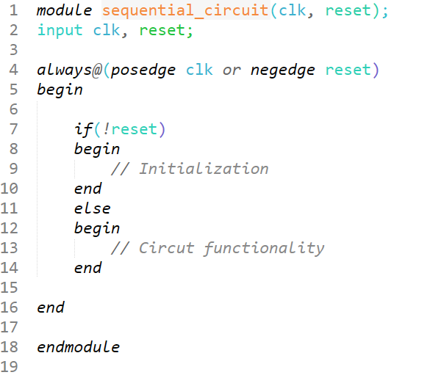
Sequential Circuit (2/3)
正緣同步電路
低位準非同步重置

Slide 5
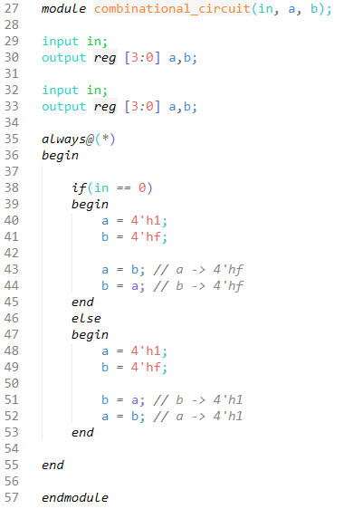
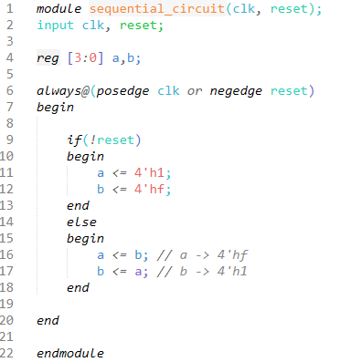
Sequential Circuit (3/3)
Blocking statement vs nonblocking statement

Slide 6
Lab I (1/3)
請設計一個具備下列功能的計數器：
正緣同步電路，低位準非同步重置
當reset訊號為0，將目前狀態暫停，輸出維持0
當reset訊號為1，每秒計數加1
EX：0 -> 1 -> 2 -> …… -> E -> F -> 0 -> ……
FPGA版之clock頻率為50MHz，需藉由除頻器將clock訊號降為1Hz
實現方式為透過一個計數器，計算經過幾個時脈正緣，當計數到50 × 10⁶ 即代表經過一秒
Notes:
可解釋為overflow

Slide 7
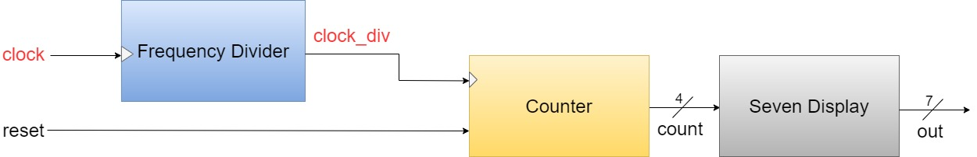
Lab I (2/3)
請將計數的數值顯示於七段顯示器
系統架構圖請參考下方
Input ：clock(CLOCK_50) , reset(SW0)
Output ：out(7 bits，HEX06~HEX00)
可使用structural description設計，其中，除頻器及計數模組為循序電路，七段顯示器控制模組則為組合電路

Slide 8
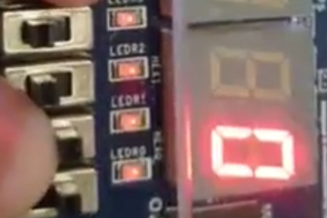
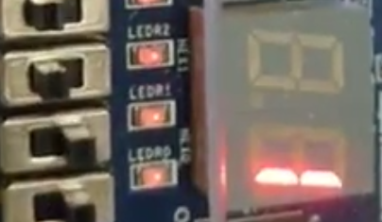
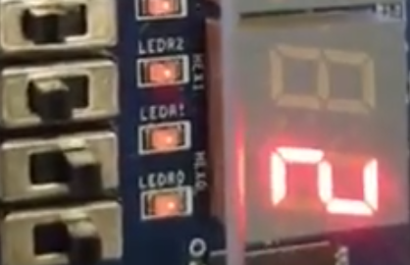
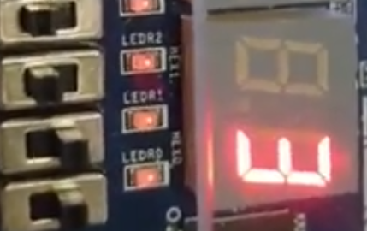
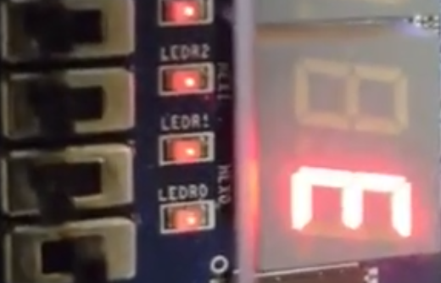
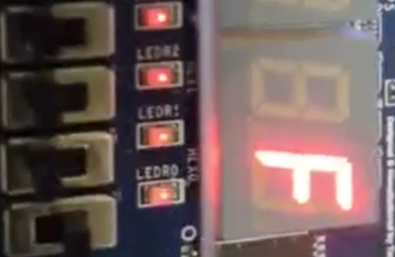
Lab I (3/3)
輸出範例
t = 16
reset
t = 1
t = 2
t = 3
…

Slide 9
Lab - Hint(1/2)
Frequency Divider (sequential circuit)
將clock頻率從50MHz降為1Hz
Counter (sequential circuit)
每秒進行計數
Seven Display (combinational circuit)
將Counter數值轉為七段顯示器控制訊號
Module呼叫範例 (Structural description)
FrequencyDivider u_FreqDiv (.clk(clock), .reset(reset), .clk_div(clock_div));
Counter u_counter(.clk(clock_div), .reset(reset), .count(count));
SevenDisplay u_display(.count(count), .out(out));
.port_name(signal_name)
module_name unit_name

Slide 10
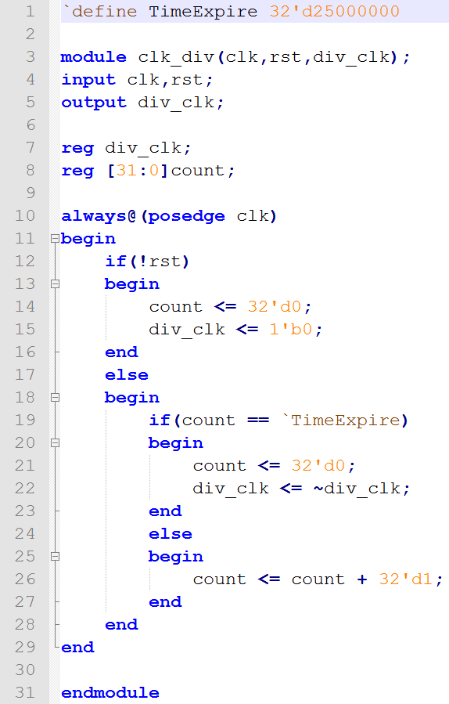
Lab – Hint(2/2)
除頻器範例：
每0.5秒改變一次訊號(div_clk)
低位準同步reset

Slide 11
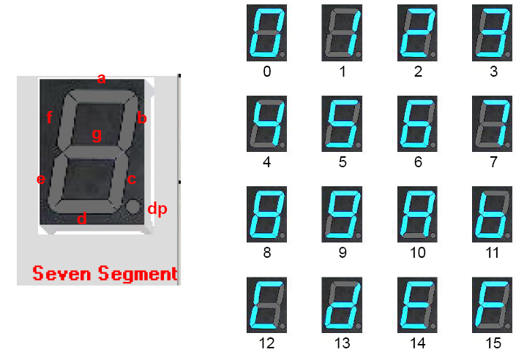
Seven-segment display(1/2)

Slide 12
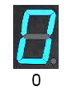
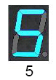
Seven-segment display (2/2)
0 is on, 1 is off
dp is useless in DE0-CV board
Ex: out=7'b1000000;
Ex: out=7'b0010010;
g=1
b=1, e=1

Slide 13
Notice
請勿命名中文或數字開頭的資料夾
Device family 請確認與 FPGA Chip 符合 (5CEFA4F23C7)
Top module name & Project name 需要一致

Slide 14
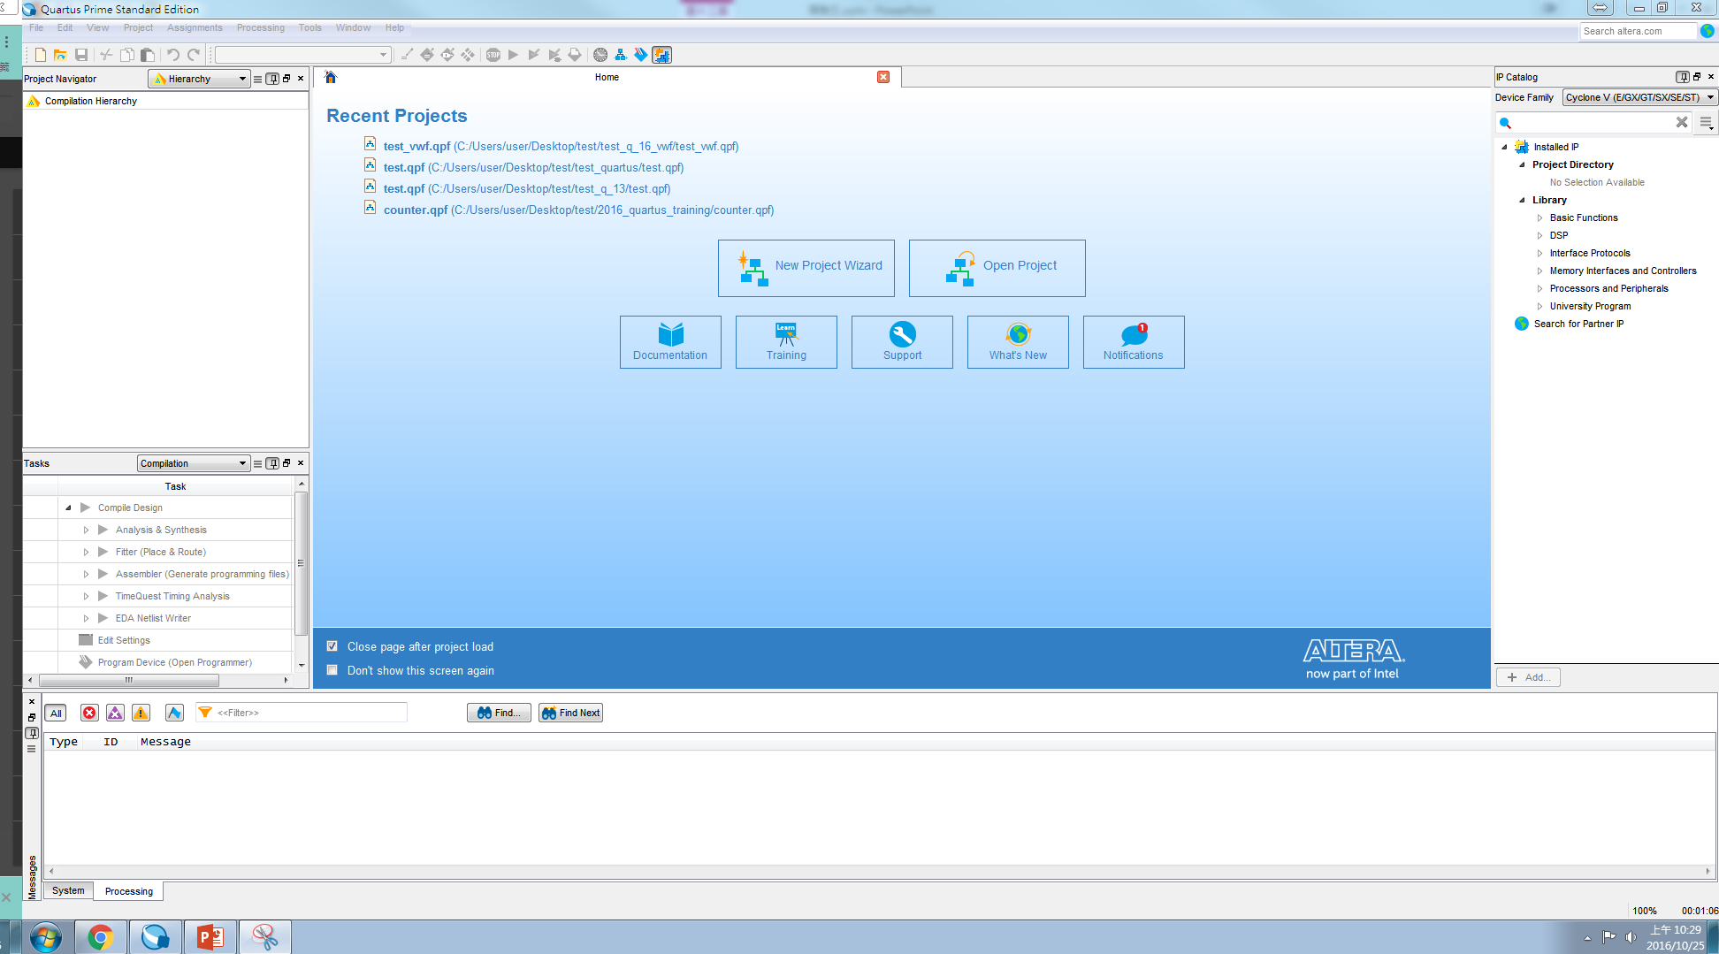
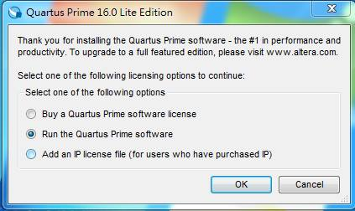
Quartus II Tutorial (1/10)
Getting Started –
Start the Quartus II software

Slide 15
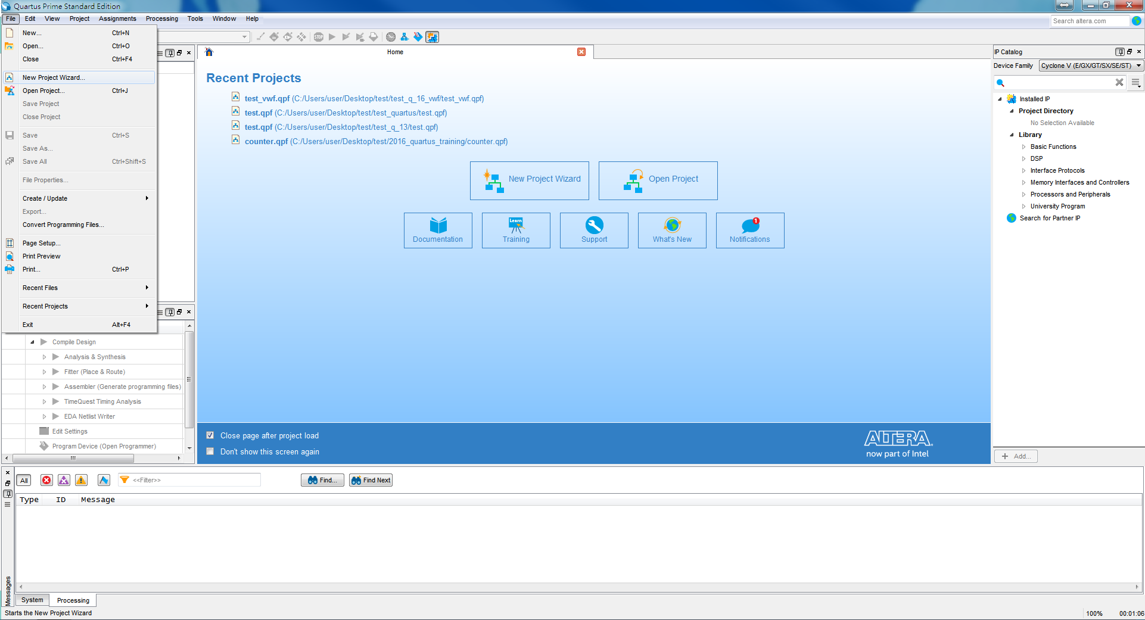
Quartus II Tutorial (2/10)
Create a New Project –
Open New Project Wizard (File → New Project Wizard…)

Slide 16
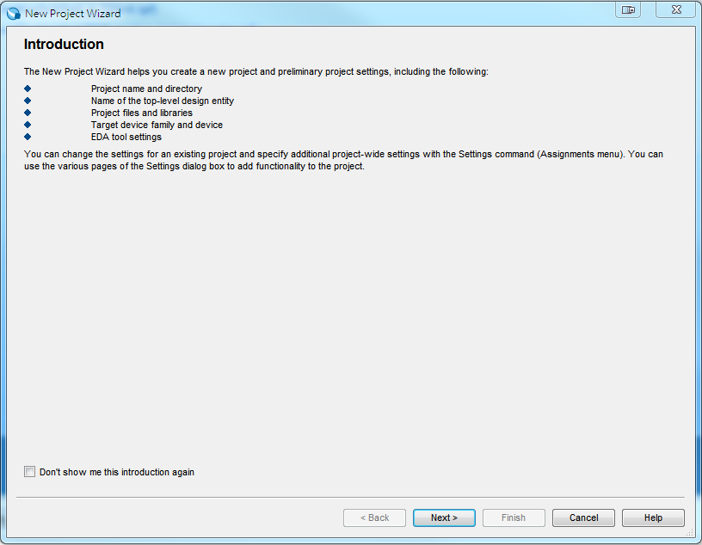
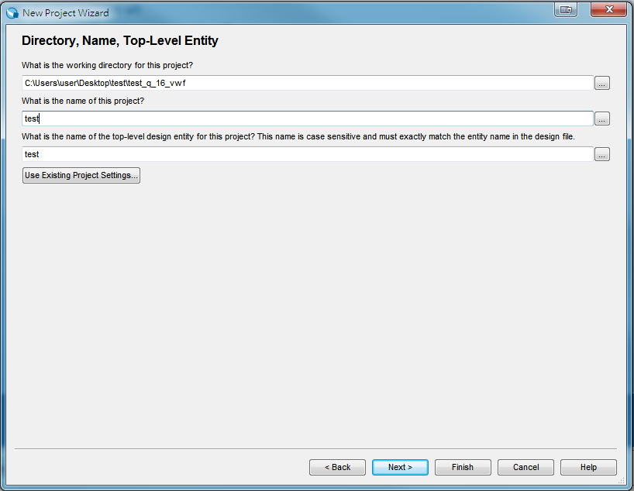
Quartus II Tutorial (3/10)
Specify the working directory and the name of the project
可先新增資料夾
請記住!名稱要相同

Slide 17
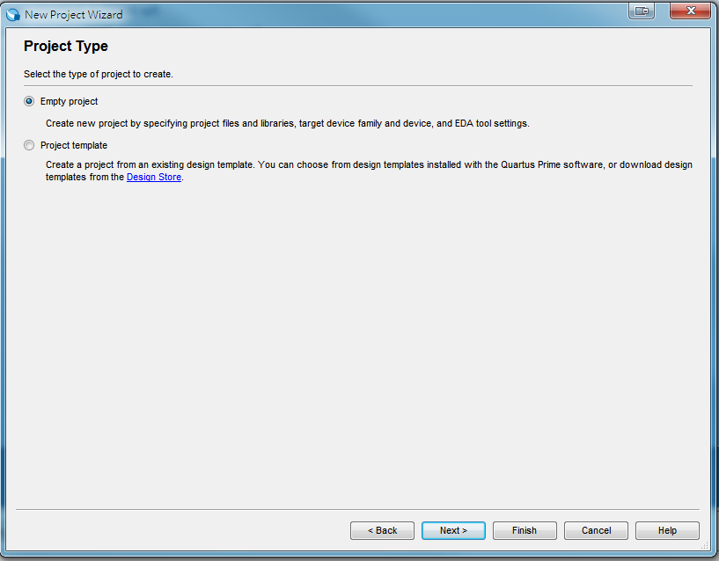
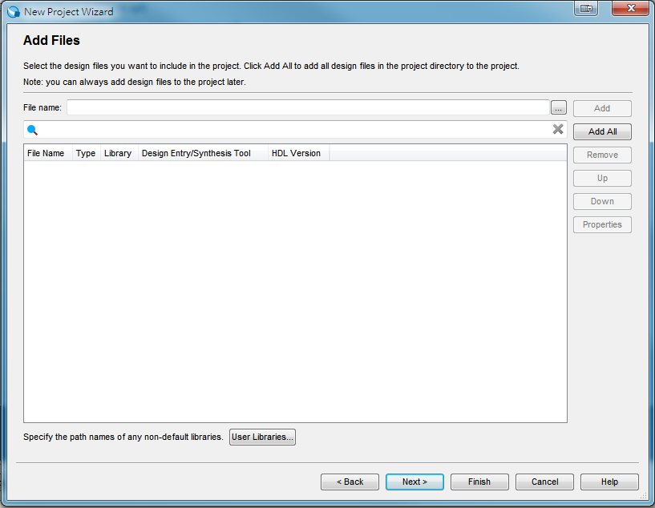
Quartus II Tutorial (4/10)
Select “Empty project”. Then, click “Next”.
Select design files. Or click “Next” to skip this step.

Slide 18
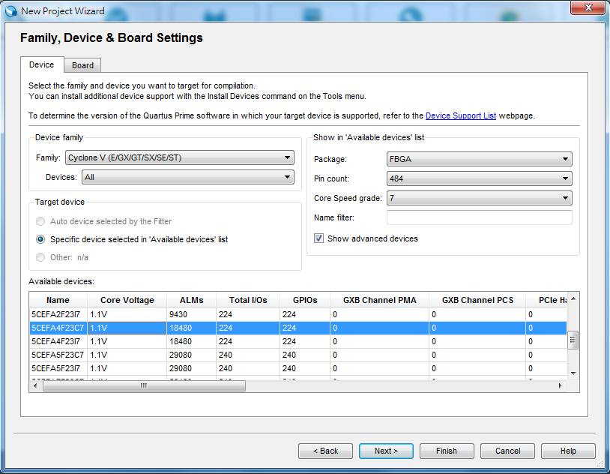
Quartus II Tutorial (5/10)
Specify device settings - (DE0-CV Device family are used). Click “Next.”
5CEFA4F23C7

Slide 19
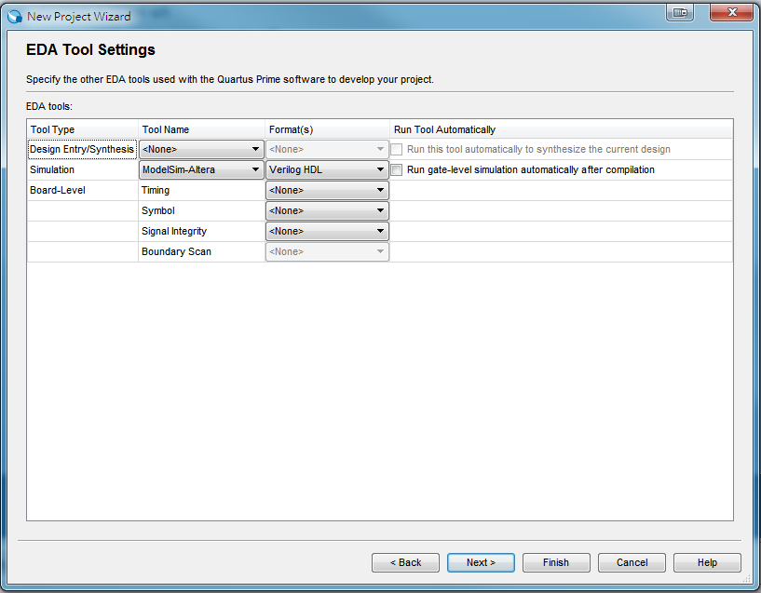
Quartus II Tutorial (6/10)
Specify EDA Tool – (Modelsim-Altera is selected for simulation). Click “Finish.”

Slide 20
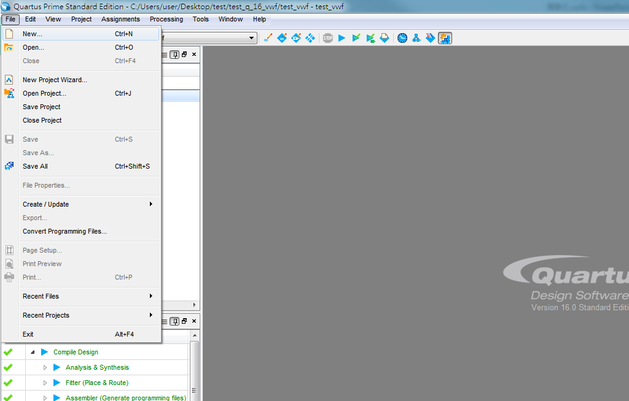
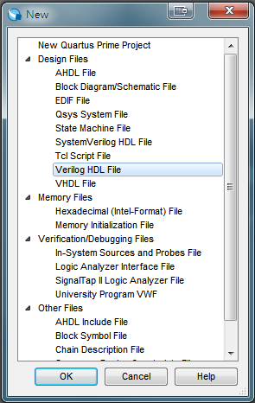
Quartus II Tutorial (7/10)
Edit a new file by opening a Verilog HDL file
(File → New → Verilog HDL File → OK)

Slide 21
Quartus II Tutorial (8/10)
Write Verilog code
Top module name 一定要跟 Project name 相同 !!
1: | //File Name：Half_Adder.v
2: | module Half_Adder(a, b, sum, carry);
3: | input a, b;
4: | output sum, carry;
5:
6: | assign sum = a ^ b;
7: | assign carry = a & b;
8:
9: | endmodule
輸入(input) |  | 輸出(output)
被加數(a) | 加數(b) | 和(sum) | 進位(carry)
0 | 0 | 0 | 0
0 | 1 | 1 | 0
1 | 0 | 1 | 0
1 | 1 | 0 | 1

Slide 22
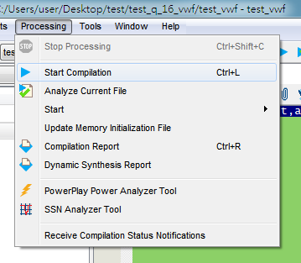
Quartus II Tutorial (9/10)
Compiling the Designed Circuit (synthesis 合成)
(Processing → Start Compilation)

Slide 23
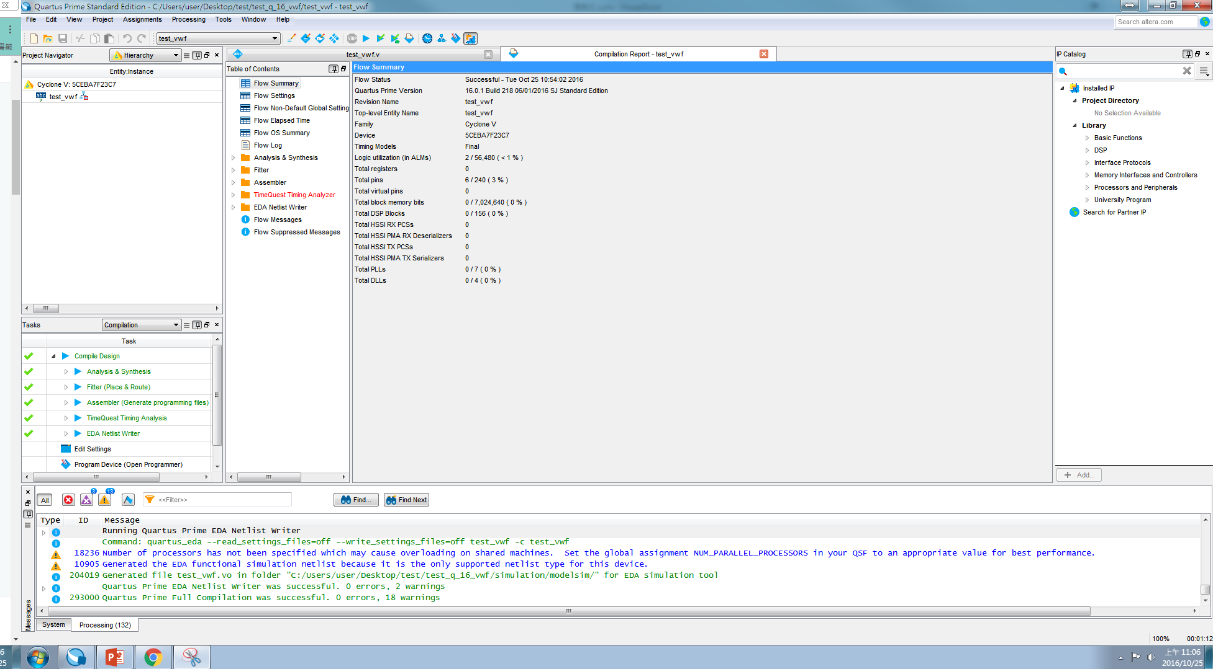
Quartus II Tutorial (10/10)
Successful compilation

Slide 24
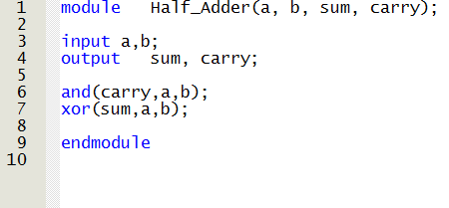
Programming DE0-CV (1/13)

Slide 25
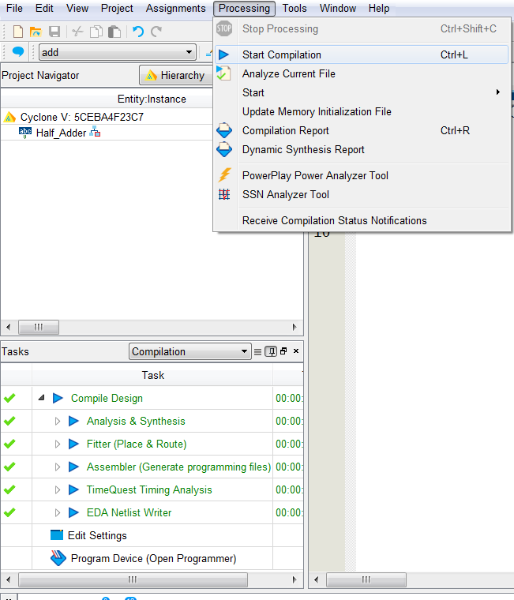
Programming DE0-CV (2/13)
Start compilation

Slide 26
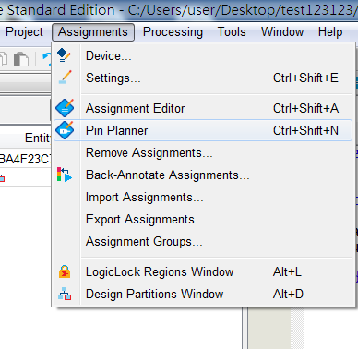
Programming DE0-CV (3/13)
Open Pin Planner

Slide 27
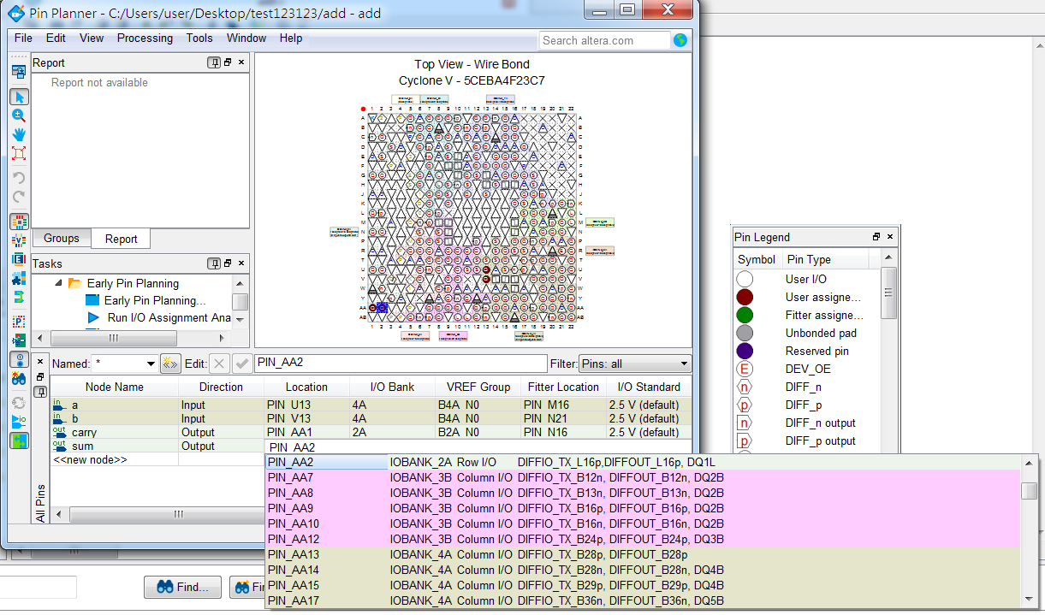
Programming DE0-CV (4/13)
Pin assignment
Double click

Slide 28
Programming DE0-CV (5/13)
Assign pin location to all inputs and outputs
Please refer to DE0_pin.xls for pin location assignment
SW0
SW1
LED1
LED0

Slide 29
Programming DE0-CV (6/13)
Start compilation

Slide 30
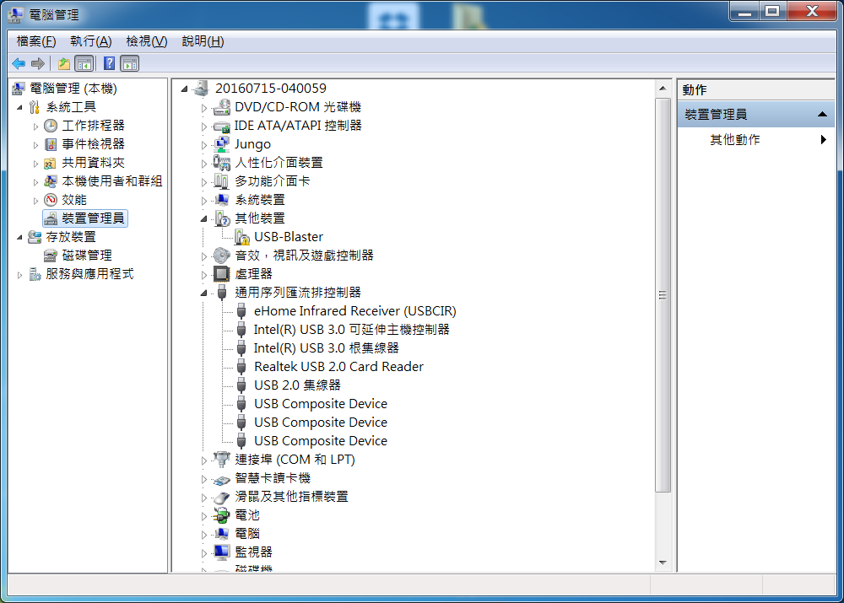
Programming DE0-CV (7/13)
右鍵選更新驅動程式軟體

Slide 31
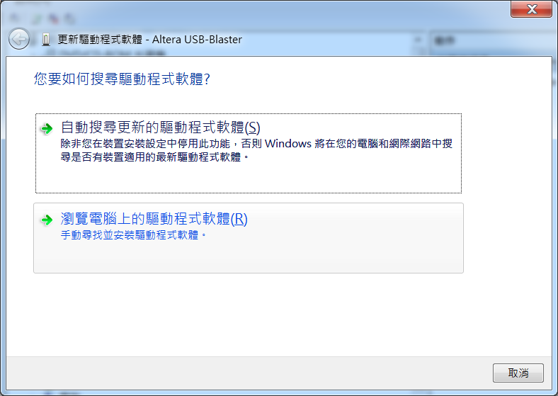
Programming DE0-CV (8/13)

Slide 32
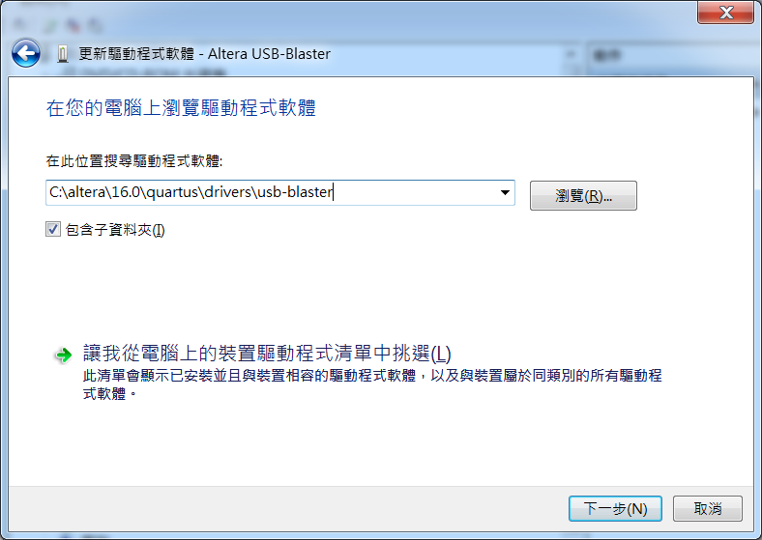
Programming DE0-CV (9/13)
Quartus Lite安裝路徑下

Slide 33
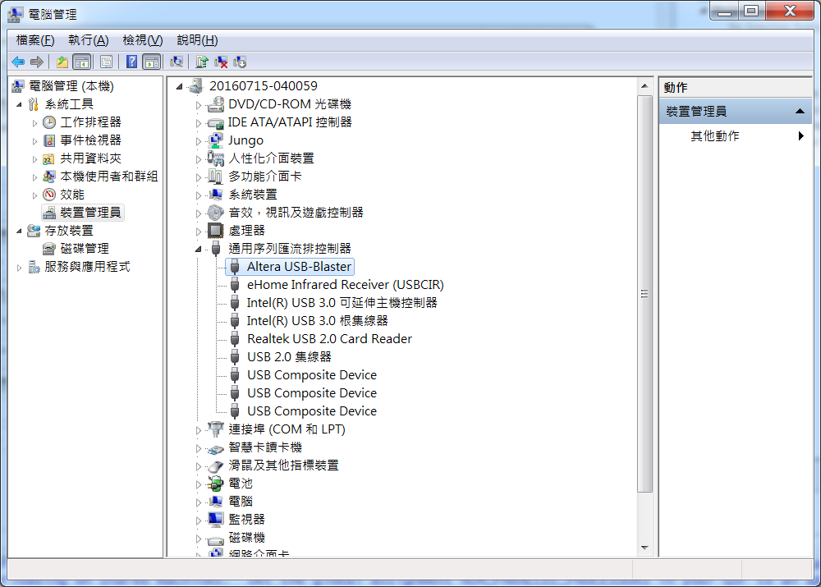
Programming DE0-CV (10/13)

Slide 34
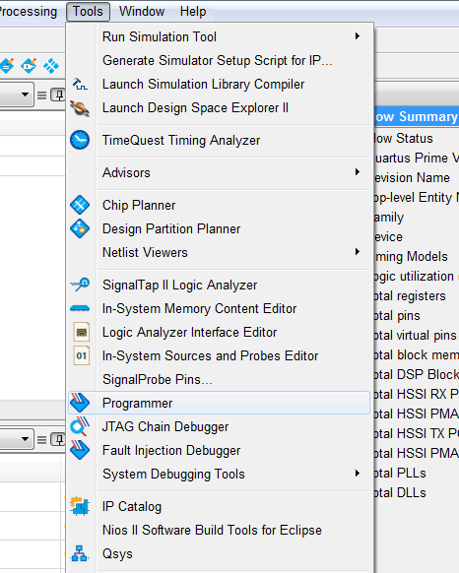
Programming DE0-CV (11/13)
Programming device

Slide 35
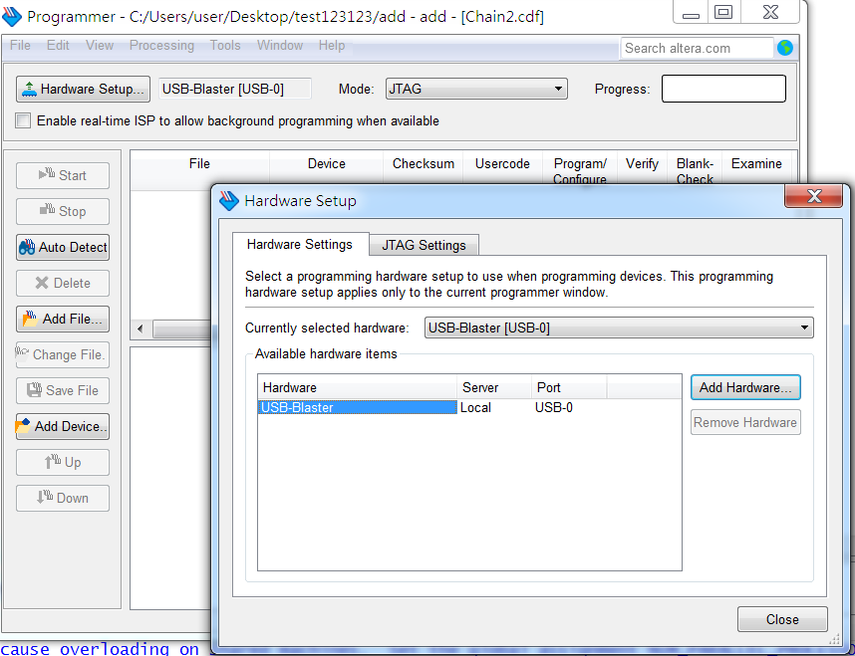
Programming DE0-CV (12/13)
Hardware setup: add USB-Blaster
1
3
2
Double click

Slide 36
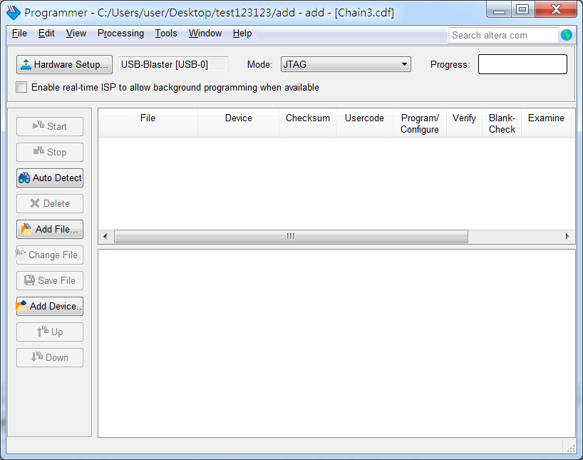
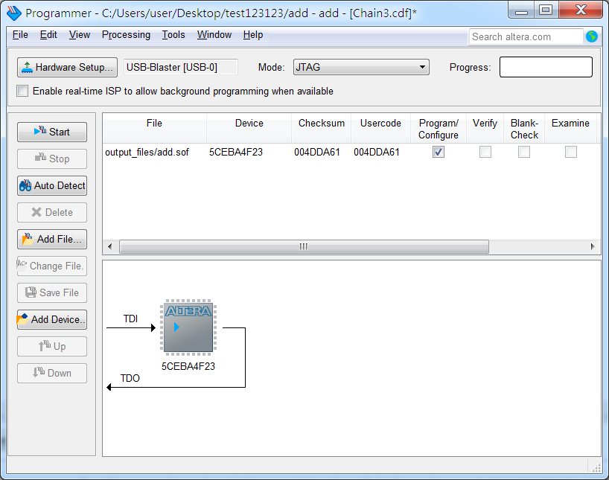
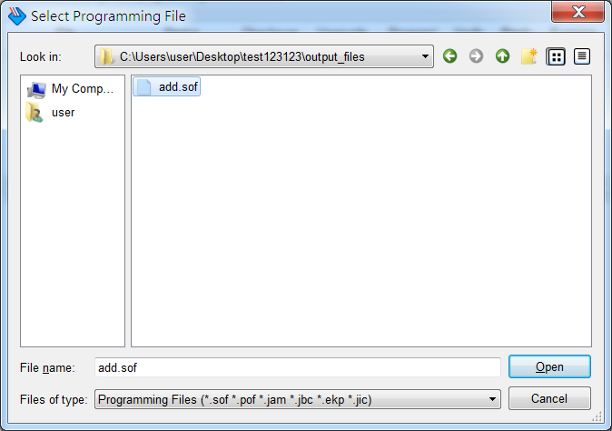
Programming DE0-CV (13/13)
Programming device

